Slide 1
LR Parser for Evaluating and Differentiating Mathematical Expressions
Implementation and Comparison in Python and Haskell
Dor Shabat
Yuval Rozner
08/08/2024

Slide 2
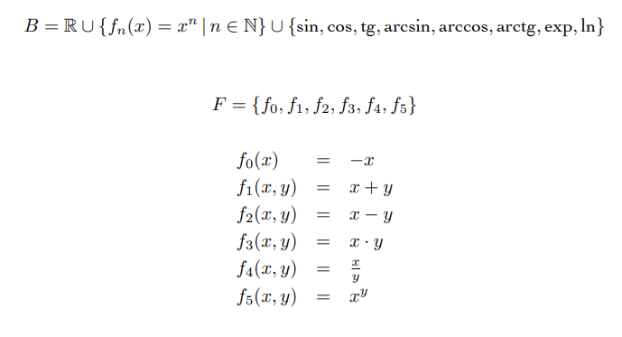
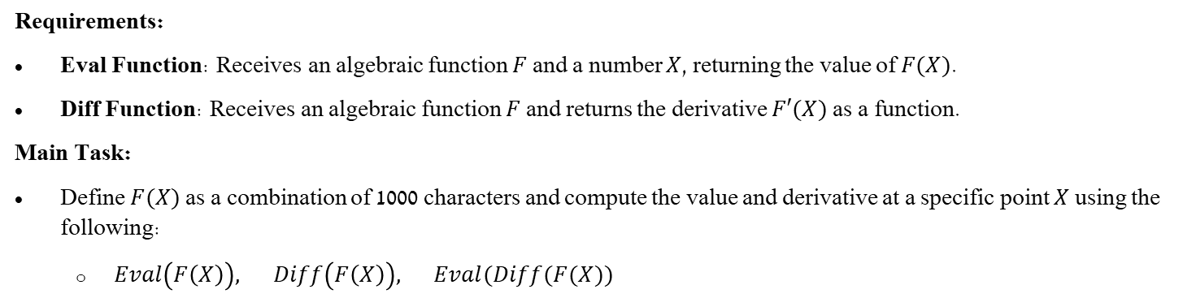
The Problem
The goal is to compute the value and derivative of a composite algebraic function.
Requirements:
Eval Function: Receives an algebraic function $F$ and a number $X$, returning the value of $F(X)$.
Diff Function: Receives an algebraic function $F$ and returns the derivative $F′(X)$ as a function.
Main Task:
Define $F(X)$ as a combination of 1000 characters and compute the value and derivative at a specific point $X$ using the following:
$Eval\left(F\left(X\right)\right), Diff\left(F\left(X\right)\right), Eval(Diff(F(X))$

Slide 3
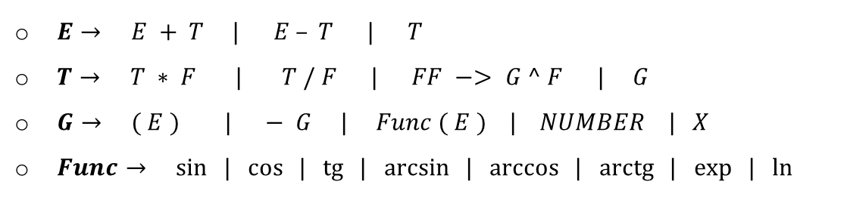
LR Parsing Overview
Context-Free Grammar
Defining Context-Free Grammar (CFG)
$E→ E + T | E – T | T$
$T→ T ∗ F | T / F | FF −> G ^ F | G$
$G→ ( E ) | − G | Func ( E ) | NUMBER | X$
$Func→ sin⁡ | cos⁡ | tg⁡ | arcsin⁡ | arccos⁡ | arctg⁡ | exp⁡ | ln⁡$
Constructing the Automaton
Building the Parsing Table
Tokenize the Expression
Parsing the Expression
Evaluation
Differentiate

Slide 4
Parsing Table
We used a web tool in : https://cyberzhg.github.io/toolbox/ which construct automaton for LR(0) grammars and construct parsing table for given grammars.

Slide 5
Python Implementation Overview
• Structure:
• Tokenization
• LR Parser class (parsing table, evaluation, and differentiation)
• Node class (tree representation and differentiation)
• Key Features:
• Dynamic typing, ease of integration with numerical libraries (e.g., NumPy).
• Python's flexibility in handling large expressions.

Slide 6
Haskell Implementation Overview
• Structure:
• Functional approach to parsing and differentiation.
• Strong typing ensures correctness at compile time.
• Key Features:
• Haskell's lazy evaluation and pattern matching.
• More concise and mathematically rigorous expression handling.

Slide 8
Performance Comparison
Haskell LR Parser | Python LR Parser | Existiong Python Solutions
 |  |  | Evaluation
 |  |  | Differentiate

Slide 9
Example

Slide 10
Thank You !
Dor Shabat
Yuval Rozner

